Slide 1
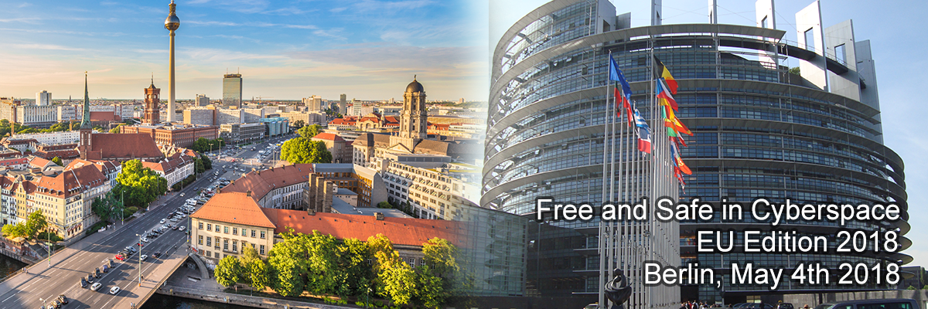
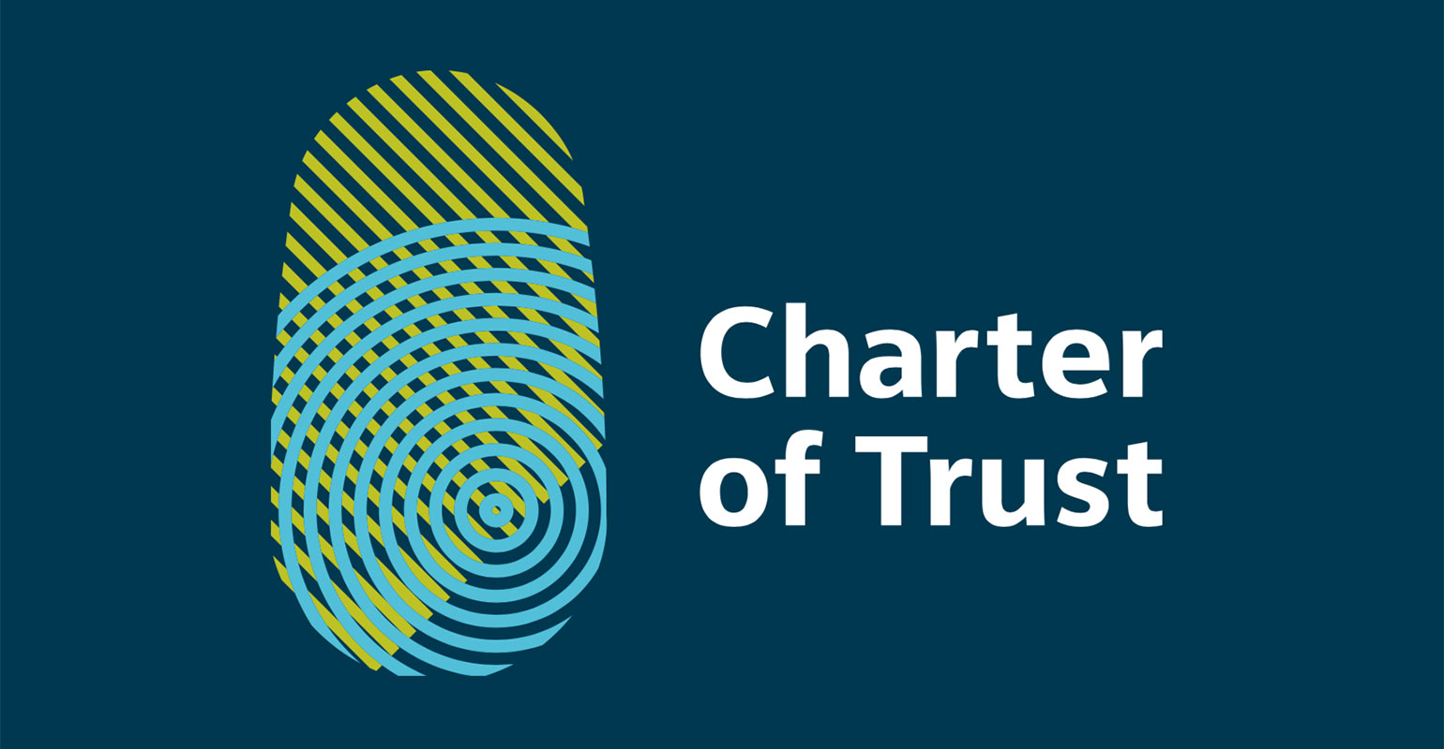
Charter of Trust:
a far-reaching initiative
Ludmila Morozova-Buss
Berlin, Germany

Slide 2
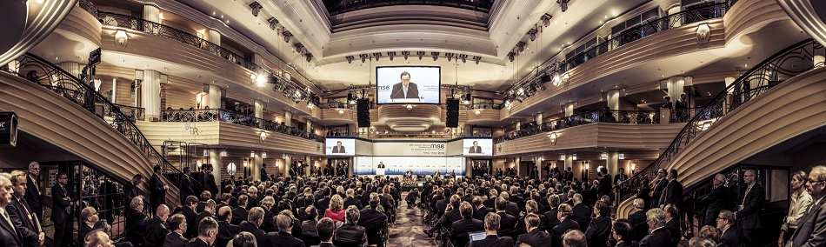
Charter Of Trust:
An Unprecedented Cybersecurity Strategic Initiative
On February 16, 2018, at the Munich Security Conference leading decision-makers of international security policy signed the Charter of Trust – baseline strategic standards for cybersecurity – for a secure digital world.

Slide 3

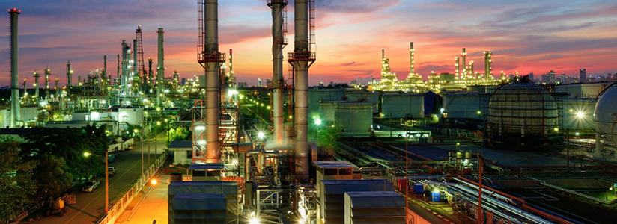
Charter Of Trust:
CERAweek® Membership Expansion
On March 08, 2018 at the CERAweek® 2018 in Houston, TX, Siemens and the eight founding members welcomed The AES Corporation, Atos and Enel to the Charter of Trust expanding the strategic global cybersecurity initiative.

Slide 4













Slide 5
Charter of Trust Members Commitment
An unprecedented cybersecurity initiative established with three primary goals:
  Protect the data of individuals and businesses;
  Prevent harm to people, businesses, and infrastructure; and
  Establish a reliable basis where confidence in a networked, digital world can take root and grow.

Slide 6
Charter of Trust Fundamental Principles
Ten Strategic Principles Fundamental to a secure digital world
Ownership for cyber and IT security
Responsibility throughout the digital supply chain
Security by default
User-centricity
Innovation and co-creation
Education
Certification for critical infrastructure and solutions
Transparency and response
Regulatory framework
Joint initiatives

Slide 7
Charter of Trust Partner: Siemens AG
Siemens AG SIE: (ETR)
HQ: Berlin and Munich, Germany
  A global technology powerhouse that has stood for engineering excellence, innovation, quality, reliability and internationality for 170 years
Website: www.siemens.com

Slide 8
Charter of Trust Partner: AES
The AES Corporation AES: (NYSE)
HQ: Arlington, VA, the USA
  Fortune 200 global power company providing affordable, sustainable energy to 15 countries through the diverse portfolio of distribution businesses as well as thermal and renewable generation facilities.
Website: www.aes.com

Slide 9
Charter of Trust Partner: Airbus Group
Airbus Group AIR: (ETR)
HQ: Leiden, Netherlands
  International pioneer in the aerospace industry. A leader in designing, manufacturing and delivering aerospace products, services and solutions to customers on a global scale.
Website: www.airbus.com

Slide 10
Charter of Trust Partner: Allianz
Allianz SE ALV: (ETR)
HQ: Munich, Germany
  Founded in Berlin on 5 February 1890! Allianz is a European financial services company.
  Its core businesses are insurance and asset management.
Website: www.allianz.com

Slide 11
Charter of Trust Partner: Atos
Atos Corporation AXI: (FRA)
HQ: Bezons, France
  European IT services corporation specializing in hi-tech transactional services, unified communications, cloud, big data and cybersecurity services. Atos operates worldwide.
Website: www.atos.net/en

Slide 12
Charter of Trust Partner: Daimler
The Daimler Group DAI: (FWB); DAX
HQ: Stuttgart, Germany
  One of the world’s biggest producers of premium cars and the world's biggest manufacturer of commercial vehicles with a global reach. The Daimler Group provides financing, leasing, fleet management, insurance and innovative mobility services.
Website: www.daimler.com

Slide 13
Charter of Trust Partner: IBM
International Business Machines Corporation IBM: (NYSE) DJIA; S&P 100; S&P 500
HQ: Armonk, NY, United States
  American multinational technology company, with operations in over 170 countries. Big Blue, is one of 30 companies included in the Dow Jones Industrial Average.
Website: www.ibm.com

Slide 14
Charter of Trust Partner: Munich Security Conference
Munich Security Conference
HQ: Munich, Germany
  Since its inception in the fall of 1963, the Munich Security Conference - MSC's objective is to build trust and to contribute to the peaceful resolution of conflicts by sustaining a continuous, curated and informal dialogue debate within the international security community.
Website: https://www.securityconference.de/en

Slide 15
Charter of Trust Partner: NXP
NXP® Semiconductors N.V. VNX: (FRA)
HQ: Eindhoven, Netherlands
  Dutch global semiconductor manufacturer. NXP® enables secure connections and infrastructure for a smarter world, advancing solutions that make lives easier, better and safer. The world leader in secure connectivity solutions for embedded applications.
Website: www.nxp.com

Slide 16
Charter of Trust Partner: SGS
SGS S.A. SUVN: (FRA)
HQ: Geneva, Switzerland
  World’s leading inspection, verification, testing and certification company. Recognized as the global benchmark for quality and integrity.
Website: www.sgs.com

Slide 17
Charter of Trust Partner: Deutsch Telekom
Deutsche Telekom AG, DTE: (ETR)
HQ: Bonn, Germany
  German telecommunications company. The largest telecommunications provider in Europe by revenue. The company operates several subsidiaries worldwide, including the mobile communications brand T-Mobile.
Website: www.telekom.com/en

Slide 18
Charter of Trust Partner: Enel
Enel Group ENL: (FRA)
HQ: Rome, Italy
  An Italian multinational energy company and one of the world’s leading integrated electricity and gas operators. Enel‘s portfolio of power stations is highly diversified, running on hydroelectric, wind, geothermal, solar, thermoelectric and other renewable sources of power.
Website: www.enel.com

Slide 19
Q&A
Thank You!
Ludmila Morozova-Buss
Berlin, Germany

