Slide 1
IT technologies and certifications needs and perspectives for Europe
Reinhard Posch
CIO of the Austrian Government

Slide 2
trust is what you feel – trustworthyness is what it really is !!!
trust-worthyness
vendor interests – national interests –user interests ???
the aim of certficatinon is to gain comparability -
SECURITY -CERTIFICATION
certi-fication
trust in IT
systems ???
?
INNOVATION .. it need quite some further steps to get there –

Slide 3
whom do we have to trust (examples)
TRUST AND SOCIAL MEDIA
can you really be sure that (e.g. even if whatsapp is offering client side encryption) there are no third parties invited to the communication where the notification for the invitation is suppressed???
TRUST AND MICROSOFT
we have to trust that the certificates managing updates are properly handled. Will the compexity of modern system enable/allow provable trustworthiness?
TRUST AND LENOVO
hardware could eventually compromise nearly any security. By or without intention – e.g. advanced side channeel techniques
TRUST AND CSPs
probably the easiest aspect. However, what are the incentives to do it properly (e.g. liabilities, security hardware… ).
TRUST AND CLOUD
SPECTRE and MELTDOWN are game changers in this field – but no one is ready for the debate
INNOVATION – INNOVATION -
WITH THE ENISA AND CERTIFICATION REGULATION EUROPE IS LOOKONG FOR SOME ANSWERS

Slide 4
THE ROLE OF THE STATE?
STATES HAVE INHERENT AMBIGUITIES
national security
criminal investigation
protection of businesses and citizen
SETTING MINIMAL STANDARDS
for critical infrastructures
for key industries
for the IT-Security sector itself
for IoT
PROVIDING TRUSTWORTHYNESS – ENABLING LIABILITIES
eIDAS
eID
siganture
QWACs
certification
INNOVATION – INNOVATION -

Slide 5
jurisdiction awareness to complement security
„THE INTERNET – NUMBERPLATE“
JURIS-
DICTION
C
AREA B
JURIS-
DICTION
A
AREA A
J-X A-B
JURIS-
DICTION
B
AREA B
JURIS-
DICTION
E
AREA C
J-A A-A
J-X
A-X
JURIS-
DICTION
D
AREA B
J-D A-B
JURIS-
DICTION
F
AREA A
J-F A-A
J-F A-A
THE „X-STICKER“ added by provider in case legal responsibility not taken
ASSUME E-BUSINESS BEING ABLE TO TAKE ADVANTAGE OF SUCH STRUCTURE

Slide 6
IoT adds a further dimension
The current 7-Series BMW and S-class Mercedes
about 100 processors apiece
washers, heaters, cameras,
tv, radio …
meters, alarms, robots, …
traffic, cars, planes, …
processors everywhere
the big difference as
these are going internet
at present security is definitely NOT first in these concepts

Slide 7
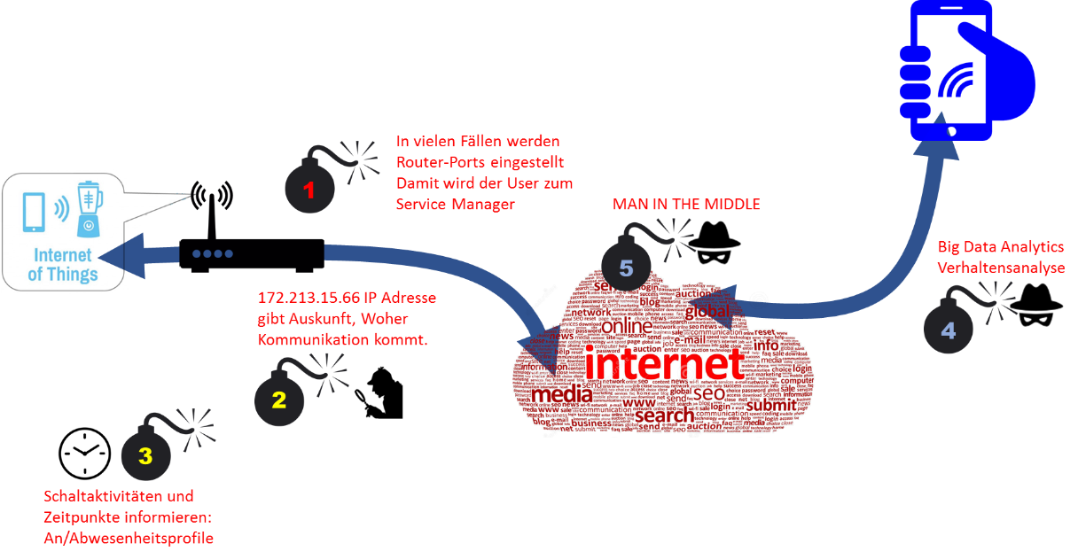
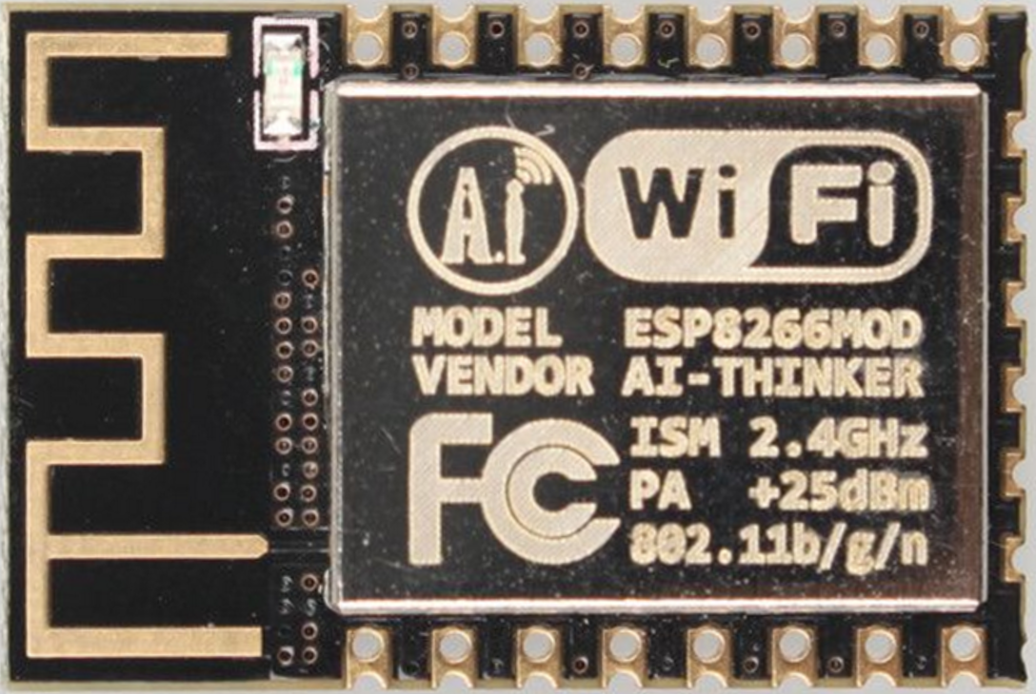
IoT – the great UNKKNOWN
< € 2 incl shipping
COMPUTER +
SSD +
WiFI
In many cases incoming mobility and APPs ports are recommended with the user becoming a service manager
Big Data can reveal behaviour
172.213.15.66 IP addresses can reveal location
UNLESS WE ACT NOW WE MIGHT GET INTO A SITUATION WE MIGHT NOT MANAGE
switching activities can leak information about profiles (e.g. at home/on vacation)

Slide 8
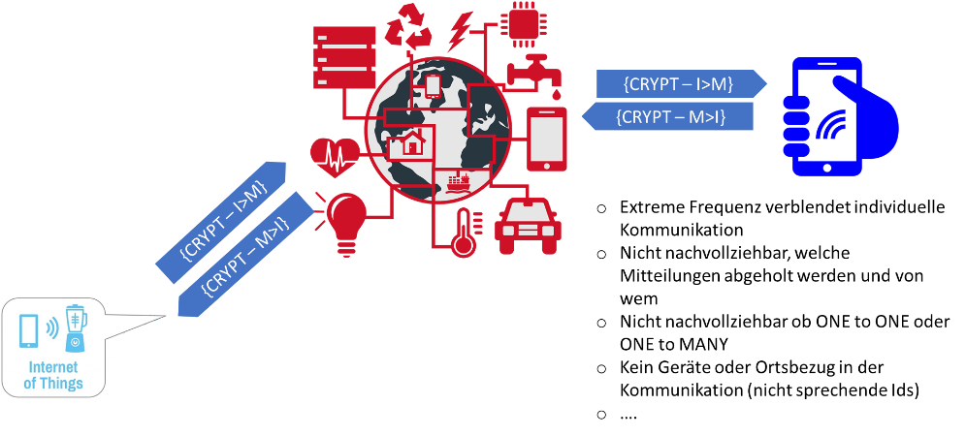
setting security and certification standards deriving liabilities
hiding communication in the big mass
hiding information about who is talking to whom
Mixing ONE TO ONE – ONE TO MANY
Random Ids remove info about location and devices from readable communication
strengthening EU-industry

Slide 9
THANK YOU FOR LISTENING
INNOVATION – INNOVATION -

